Slide 1
WEB PROGRAMMING
Project Developed By
R SRAVAN KUMAR
Under the Guidance of
Mr. SATYANARAYANA MURTHY

Slide 2

PROJECT AGENDA
E - COMMERCE WEBSITE
SCREENSHOTS

Slide 3
CONTENTS
Introducing to WEB PROGRAMMING/TECHNOLOGY
Technologies learned
Software & Hardware Requirements
Project Description
Project Modules
Screenshots
Conclusion

Slide 4
TECHNOLOGIES LEARNED
HTML5, JAVASCRIPT, SERVLETS, TOMCAT SERVER, JSP
SOFTWARE & HARDWARE REQUIREMENTS
NetBeans v8.2
Processor i3
Hosting: Apache Tomcat 9.0
Database: MySQL 5.7 server

Slide 5
WHAT IS WEB PROGRAMMING ?
Web development is a broad term for the work involved in developing a website for the Internet or an intranet.
Web programming refers to the writing, markup and coding involved in Web development, which includes Web content, Web client and server scripting and network security.
The most common languages used for Web programming are XML, HTML, JavaScript, Perl 5, JSP and PHP.
Web programming is different from just programming, which requires interdisciplinary knowledge on the application area, client and server scripting, and database technology.

Slide 6
FEATURES
Browser support
Can be used on client side as well as on server side
Functional programming language
Support for objects

Slide 7
What is HTML
HTML stands for Hyper Text Markup Language for creating Web pages.
HTML describes the structure of Web pages using markup
HTML elements are the building blocks of HTML pages
HTML elements are represented by tags
HTML tags label pieces of content such as "heading", "paragraph", "table", and so on
Browsers do not display the HTML tags, but use them to render the content of the page
HTML Tags
HTML tags are element names surrounded by angle brackets

Slide 8
HTML5
HTML 4
Simplified and Clear Syntax: <!DOCTYPE html> is enough to specify the document type.
Contains built in support for integrated multimedia files into web page via video and audio tags.
This issue has been addressed via Web SQL database and application cache that can be access via HTML5’s JavaScript interface.
Contains JS Web Worker API which allows JavaScript and Browser interface to run in separate threads
In HTML4 the DOCTYPE declaration was too messy and lengthy and used to refer an external source.
Multimedia content was integrated in web pages via third party plugins such as Silverlight and flash.
in order to store important data on client side, browser’s cache was used which is limited & doesn’t support relational storage mechanism.
JavaScript and the browser interface with which user interacts, run in the same thread.

Slide 9

E - COMMERCE WEBSITE
Online store to buying and selling of goods and services, or the transmitting of funds or data, over an electronic network, primarily the internet.
These business transactions occur either as business-to-business, business-to-consumer, consumer-to-consumer or consumer-to-business.
Admin can add, delete, update products.
Customer buys the products which are available in website.

Slide 10
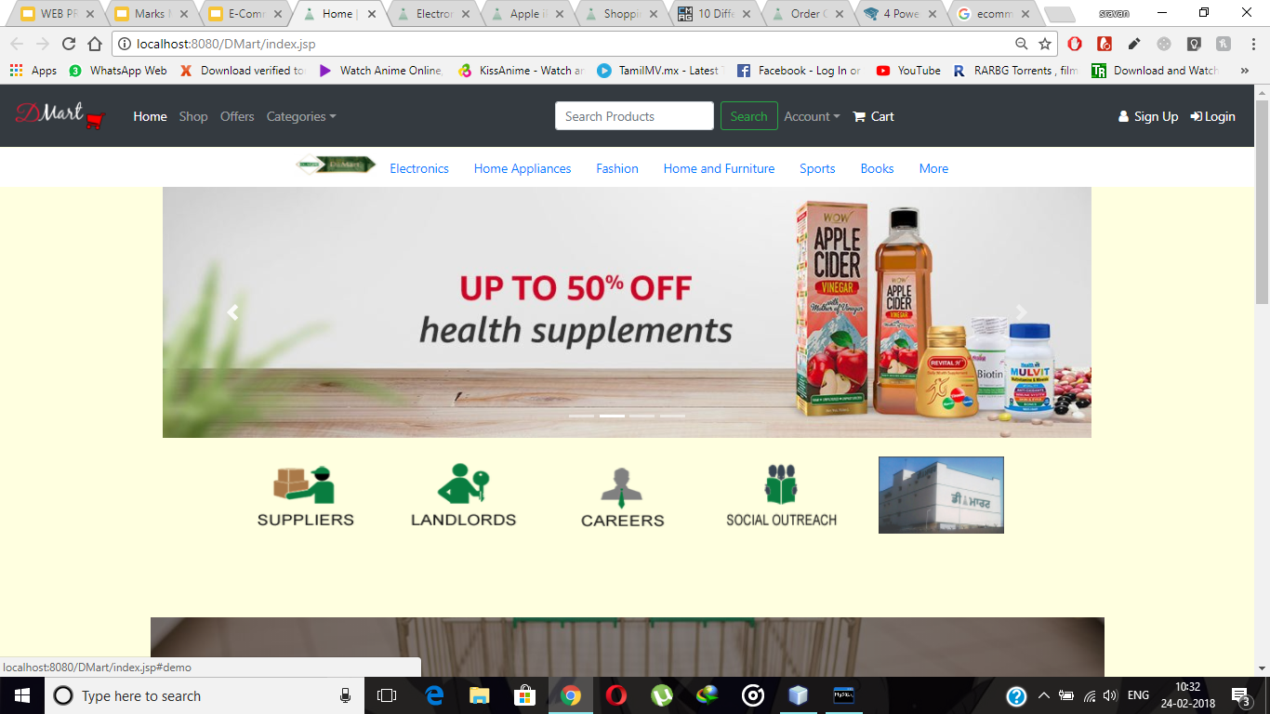

Slide 11
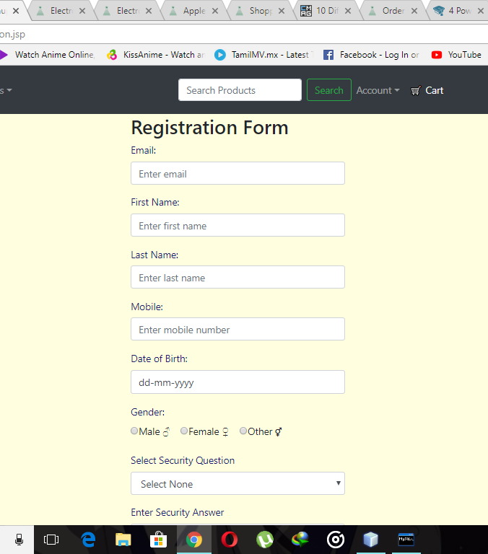
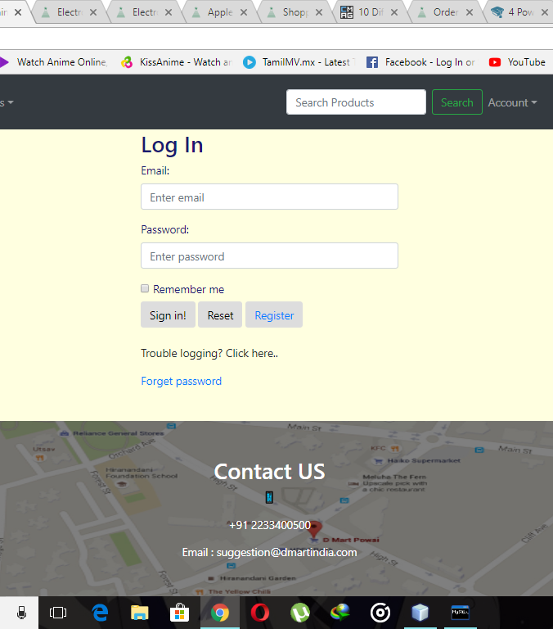

Slide 12
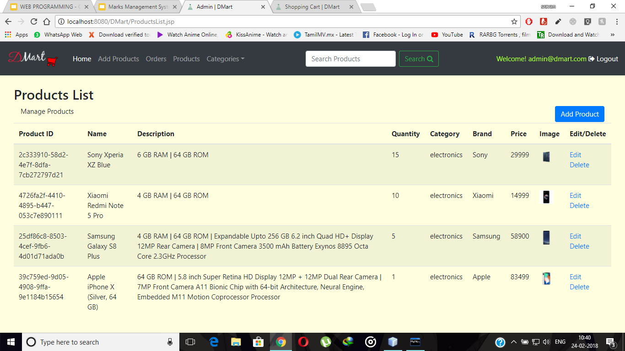

Slide 13
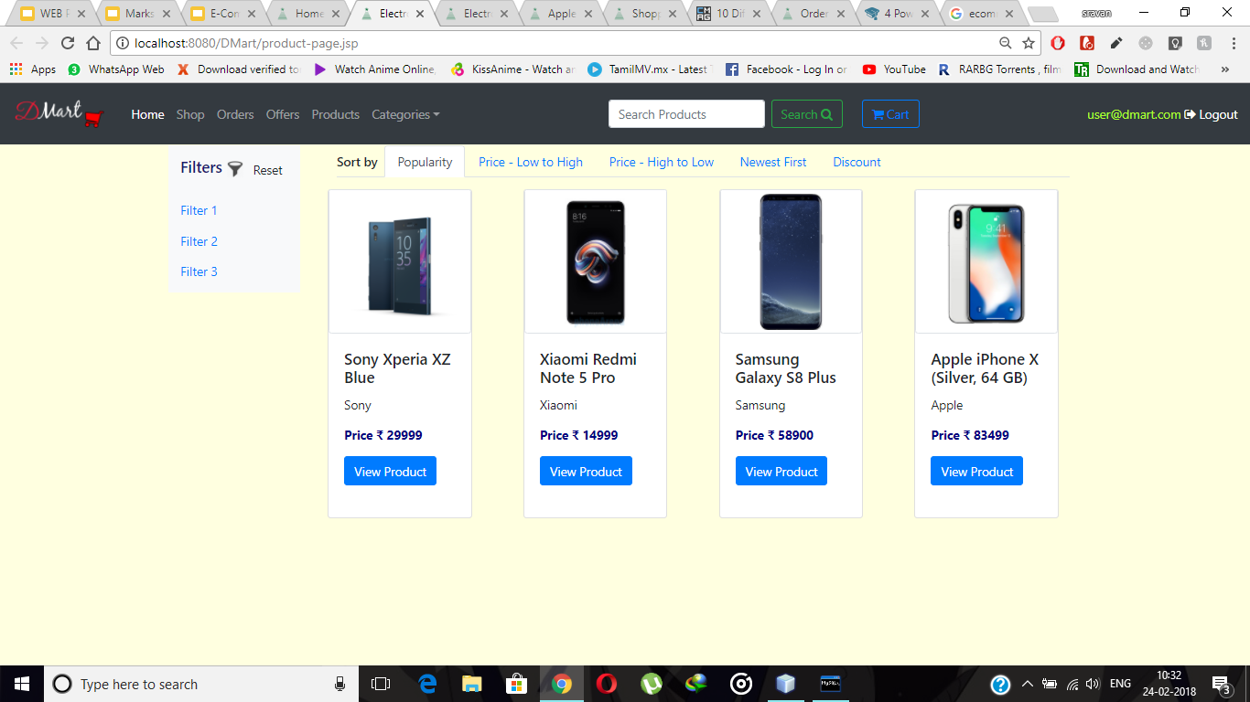

Slide 14
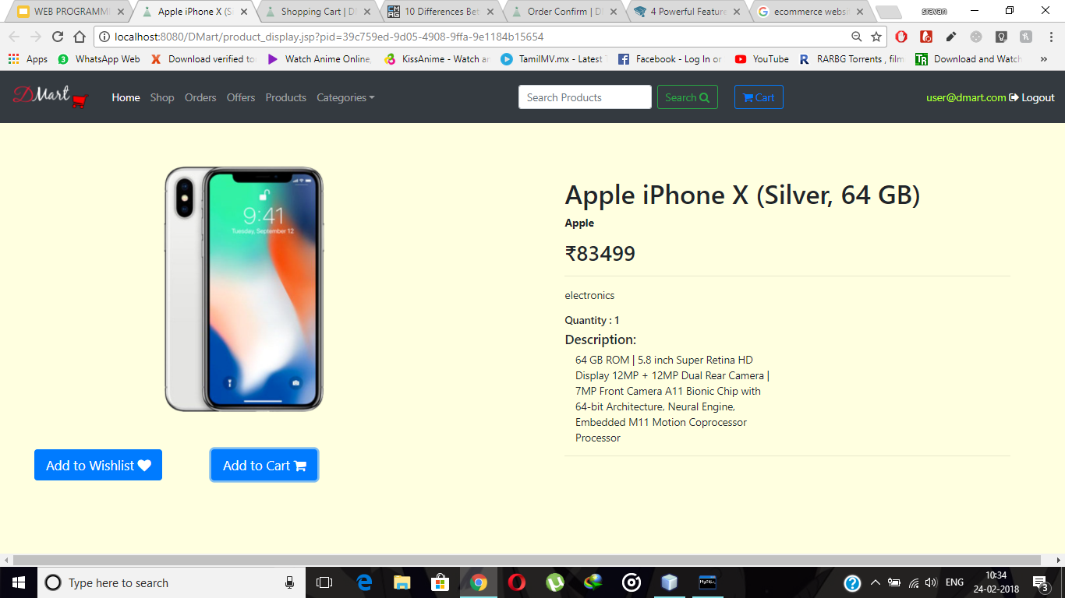

Slide 15
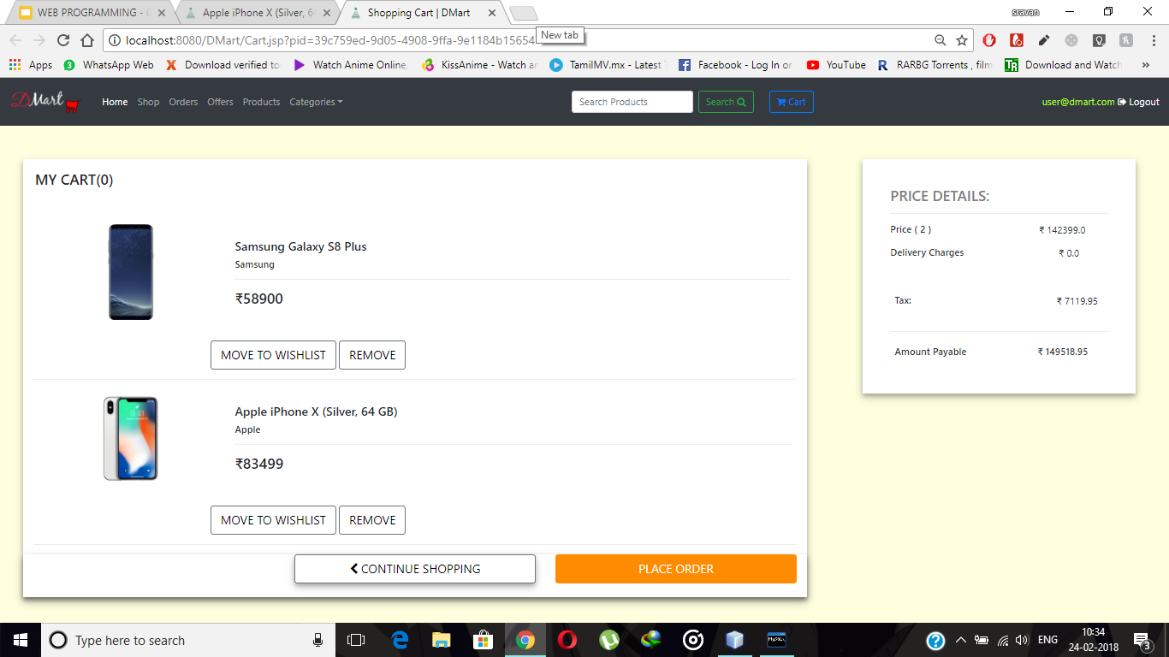

Slide 16
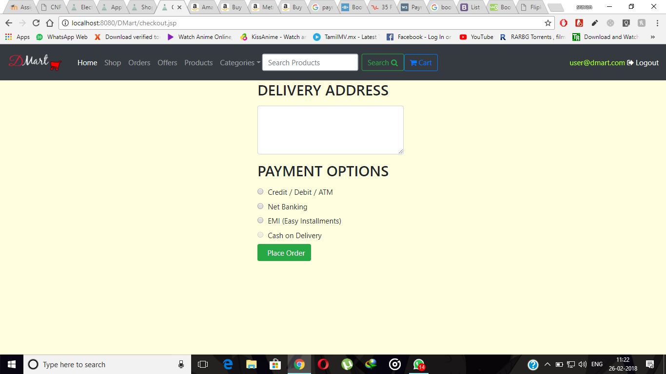

Slide 17
CONCLUSION
With the help of E - COMMERCE WEBSITE customers can buy or sell in online.
Through online it makes easy to vendors to sell products from different locations into one website.

